Slide 1
MOCRS Community Walk-through Ward 7: Benning Ridge & Marshall Heights Communities
Ward 7: Benning Ridge and Marshall Heights Communities
Muriel Bowser, Mayor
Tuesday, December 14, 2016
3:00 PM – 5:00 PM
Start: Dollar Plus Food Store– 4837 Benning Road, SE
End: Benning Park Recreation Center--- 5100 Southern Avenue SE

Slide 2
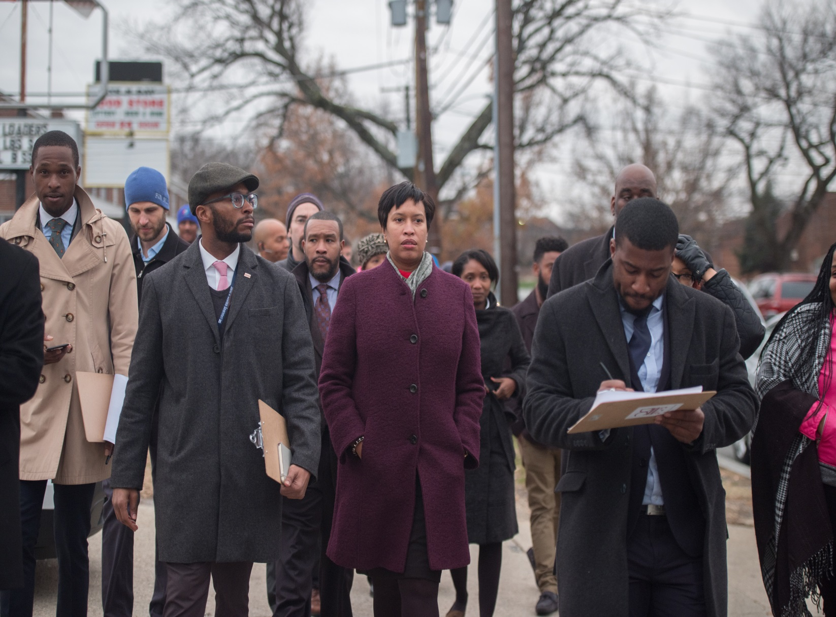
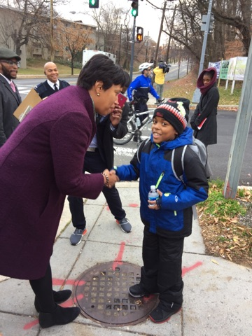
Ward 7: Benning Ridge and Marshall Heights Communities
Muriel Bowser, Mayor

Slide 3
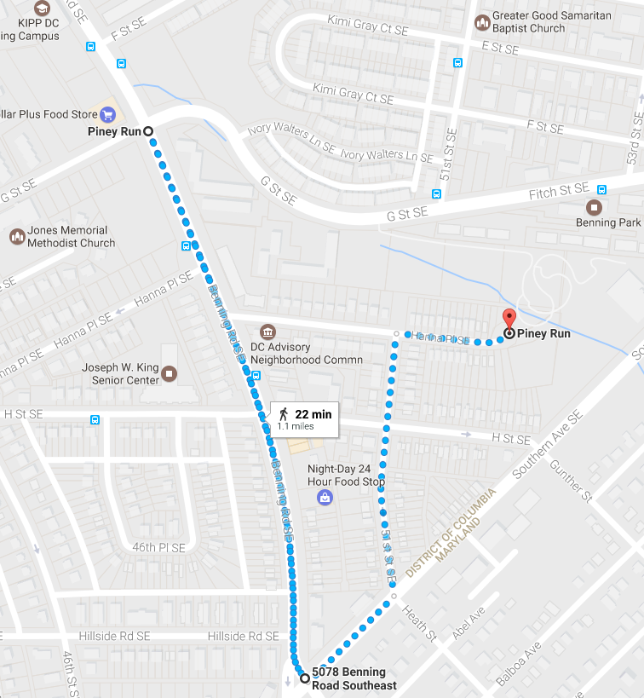
Route
Ward 7: Benning Ridge and Marshall Heights Communities
Muriel Bowser, Mayor

Slide 4
DC Government Attendees
Ward 7: Benning Ridge and Marshall Heights Communities
Muriel Bowser, Mayor
John Falcicchio, Chief of Staff of the Executive Office of the Mayor Muriel Bowser
John Schools, Chief Performance Officer of the District Department of Transportation
Peter Newsham, Interim Chief, Metropolitan Police Department
David Taylor, 6th Police District Police Commander
Melinda Bolling, Director of the Department of Consumer & Regulatory Affairs
Keith Anderson , Director of the Department of Parks & Recreation
Ana Harvey, Director of the Department of Small and Local Business Development
Brian Ferguson, Director of the Mayor’s Office of Returning Citizens
Jackie Reyes, Director of the Mayor’s Office of Latino Affairs
Thomas Bowen, Director of the Mayor’s Office Religious Affairs
Kimberly Bassett, Director of Mayor’s Office Women’s Policy & Initiatives
Tommie Jones, Director of the Mayor’s Office of Community Relations & Services
Julia Irving, Community Outreach Coordinator
Jason Medina, Sixth District Outreach Officer
Harold Beckham, DPW Inspector
Jacqueline Brooks, DPW Sweep
Jackie Stanley, Community Outreach Coordinator
Diane Preston, DPR Roving Leader

Slide 5
Community Participants
Ward 7: Benning Ridge and Marshall Heights Communities
Muriel Bowser, Mayor
Benjamin Thomas, ANC 7E01
Ebbon A Allen, ANC 7E03
Takiyah Tate, ANC 7E04
Tyrell Holcomb, ANC 7F01
Reverend Ken Brown, Landlord on 4600 Hillside Road, SE
Sandra Ware, Resident
Veda Rasheed, Resident
Ashley Harding, KIPP DC – Associate Director of Family & Community Engagement
Kevin Mehm, KIPP DC – Managing Director of Operations

Slide 6
Issues Identified and Status
Ward 7: Benning Ridge and Marshall Heights Communities
Muriel Bowser, Mayor
Issue Identified | Address or Location of Issue | Agency Owner | Estimated Resolution Date | Status
Leaf Collection Education | 4837 Benning Road SE | DPW | Short-Term | Open
Abandoned Vehicle | 4944 G ST SE | DPW/DCRA | Short-Term | Open
Nuisance Property | 4944 G ST SE | DCRA/OAG | Short-Term | Open
Trash & Debris Removal | 4900 Benning RD SE | DPW | Short-Term | Open
Vacant Property Enforcement | 4964 Hannah PL SE | DCRA | Short-Term | Open
Order of Correction: Collapsed Roof | 4964 Hannah PL SE | DCRA | Short-Term | Open
Small Landlord Loan Information (Outreach) | 4964 Hannah PL SE | DCRA | Long-Term | Open
Theo's Chicken & Waffles Carry-Out Outreach | 5013 H ST SE | DSLBD/DMPED | Short-Term | Open
Next One Barbershop | 5011 H ST SE | DSLBD/DMPED | Short-Term | Open
Billboard Restoration | 5000 Benning Road SE | DDOT | Short-Term | Open
Billboard Restoration | 5000 H ST SE | DDOT | Short-Term | Open
DBH Outreach: Substance Abuse | 5000 Benning Road SE | DBH/MPD/DCRA | Short-Term | Open
Food Store ATM: Out of Order | 5026 Benning Road SE | DCRA/DISB | Short-Term | Open
Shoes On Power Wire | 5026 Benning Road SE | OCTFME | Short-Term | Open
Mama's Laundromat: Investigate Closure | 4528 Benning Road SE | MOCRS | Short-Term | Open
Private Security Camera Outreach | 5000 Block of Benning Road SE | MOCRS | Short-Term | Open
Comprehensive Response to: K2 Abuse, Open Shooting Cases | 5000 Block of Benning Road SE | DHS, DBH, DOES, Safer Stronger | Short-Term | Open
Public Safety Concerns | 5000 H ST SE | MPD | Long-Term | Open
Crime Camera | 4600 Hillside Road SE | MPD | Short-Term | Open
Homicide Case Update: July 2016 | 5000 H ST SE | MPD | Short-Term | Open
Vacant Property Enforcement | 5100 Hannah PL SE | DCRA | Short-Term | Open
Vacant Property Enforcement | 5133 Hannah PL SE | DCRA | Short-Term | Open
DPR Community Garden | 5100 Southern Avenue SE | DPR/DGS | Short-Term | Open

Slide 7
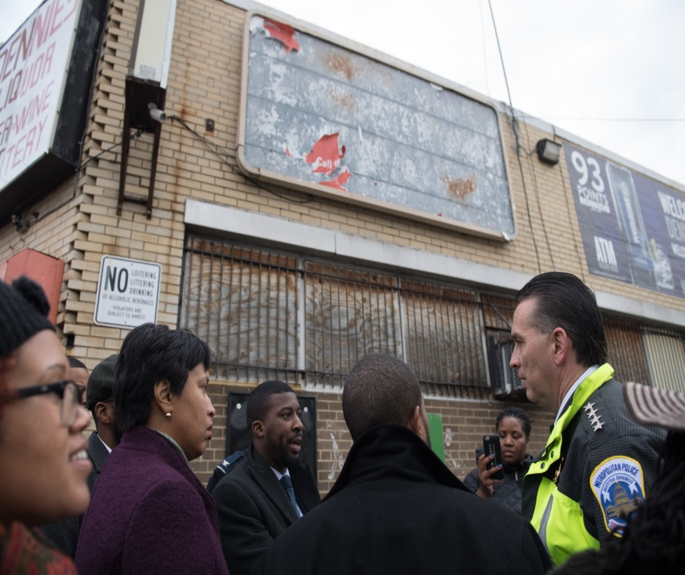
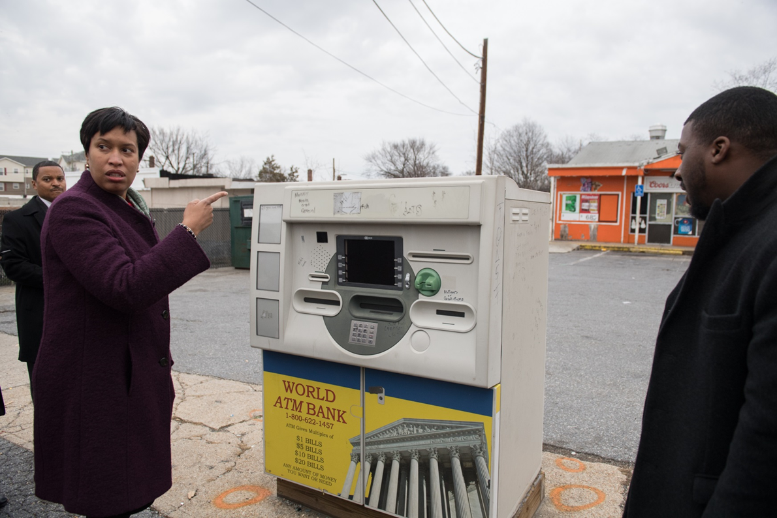
Ward 7: Benning Ridge and Marshall Heights Communities
Muriel Bowser, Mayor
Mayor Bowser is talking to Interim Police Chief Newsham about the vacant billboard and public safety issues along the 4800 block of Benning Rd SE
Mayor Bowser and Ward 7 Community Liaison Adrian Sutton discussing the community concerns regarding the blighted ATM machine along the 5000 block of Benning Rd SE

